Slide 1
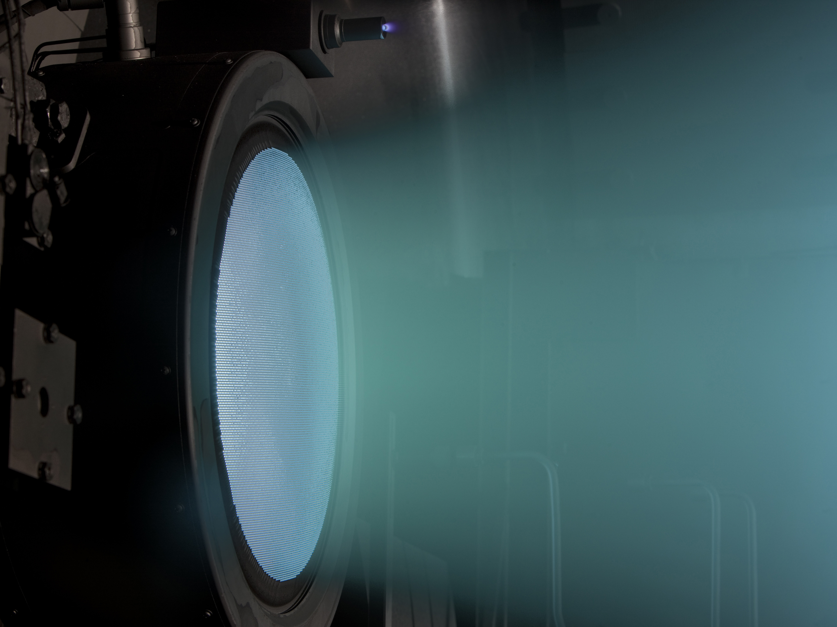
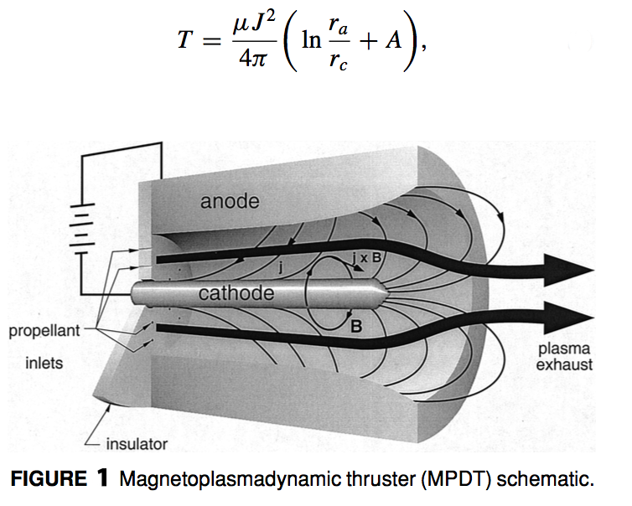
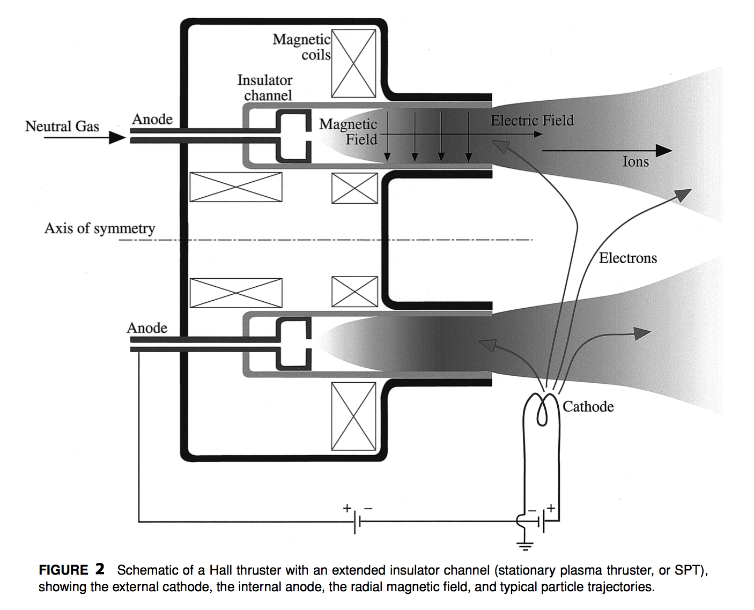
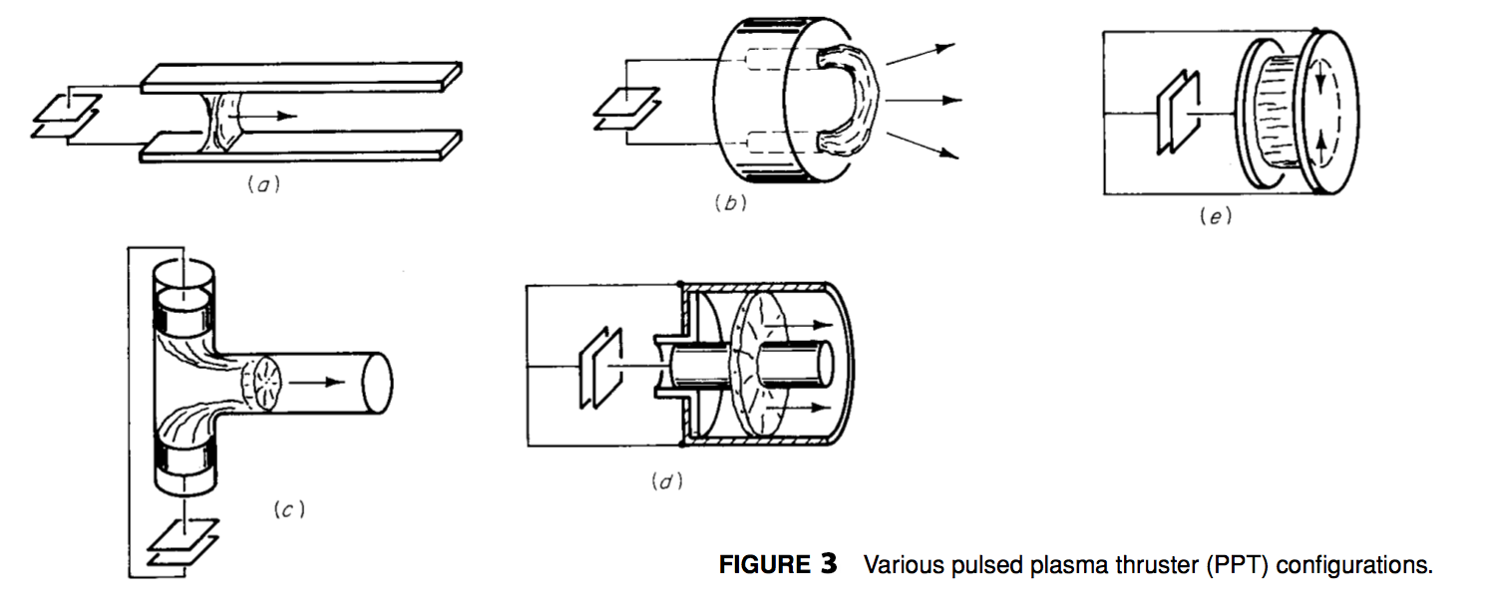


ELECTRIC PROPULSION SYSTEMS
Abstract
Current Technology (Methods and Examples)
All current and future space missions by space agencies such as NASA, JAXA, ROSCOSMOS, CSA, UKSA, ISRO, ISA, NSA, etc. require onboard propulsion systems to create acceleration and velocity movements required for space travel and maneuverability. These propulsion systems have a major impact on spacecraft mass and cost. Electric Propulsion systems create major performance advantages over current chemical systems for a variety of mission functions such as interplanetary travel and heavy cargo transportation between planets.
Since the late 1950s, there has been an extensive effort to develop the technology for high performance, on board electric propulsion systems to improve and enable near-and-far-term space missions. Efforts in Electric Propulsion include research and development efforts on electrothermal, electrostatic and electromagnetic propulsion systems. These three categories of electric propulsion devices are being designed to be included in a variety of potential applications.
This brief presentation on the basics of Electric Propulsion is designed for students with a basic knowledge of physics and/or chemistry in an effort to introduce the concept of electronic propulsion technology in a manner that makes clear the purpose, benefits, drawbacks and general nature of past, present and near-future research in the field of electronic propulsion and the long term future of space flight. Although not much in propulsion has changed in the last 50 years of space flight programs, this presentation has been compiled from research which contains current technology and scientific methods in the field of electric propulsion and modern spaceflight. Examples of the basic functions of the most common method of electric propulsion (electromagnetic propulsion) are given in the form of the three most used electric propulsion devices used in today’s modern spaceflight strategies.
Electromagnetic Propulsion
The most utilized category of Electronic propulsion relies on an electric current exposed to a conductive propellant stream with a magnetic field used to accelerate the charged propellant. By using magnetic fields to accelerate charged propellants, systems can produce much higher thrust densities those that utilize electrothermal or electrostatic propulsion alone.
The essential process of achieving electromagnetic thrust is as follows
An electrically conductive fluid, usually a highly ionized gas is subjected to an electronic field.
The electronic field creates a negatively charged plasma
Plasma is fed through a perpendicular magnetic field
The perpendicular magnetic field is charge with a positive positive charge
The positive charge accelerates the negatively charged plasma to create a streamwise body force.
This density of expelled plasma creates a thrust force which increases the velocity of the spacecraft.
Current Electromagnetic Propulsion Technologies
Electromagnetic Propulsion offers the most dynamic variety of implementations for spaceflight. Applied fields and currents utilized in ionization or acceleration of gaseous particles may be steady, pulsed or alternated over a broad range of frequencies. A broad variety of propellant types, including liquids and solids may be used, along with numerous hardware configurations related to geometry, electrode and insulator configurations, injection techniques, and methods of ionizing and ejecting the propellant.
Since the late 1950’s, a huge number of possible electromagnetic propulsion concepts have been studied, theoretically and experimentally. Only a few electromagnetic propulsion concepts have made it past development into production including:
Quasi-Steady Magnetoplasmadynamic (MPD) Thrusters
Hall-Current Accelerators
Pulsed Plasma Devices
Examples of Technologies in Production:
Magnetoplasmadynamic Thrusters (FIGURE 1)
Characteristics of MPDT devices are a coaxial geometry constituted by a central cathode, an annular anode and some form of inter-electrode insulator. Gaseous propellants are injected into the upstream portion of the channel, where they are ionized by an intense, uniform electric arc within the electrode gap.
The current within the electromagnetic field exerts the forces necessary to accelerate the propellant toward the centerline of the device, where it is compressed into an extremely hot plasma. This plasma is forced through the thruster and is expanded just beyond the cathode tip, where it creates the exhaust velocity required for uniform thrust.
Some limits to MPDT technologies are overall space, power supply, plasma instabilities and power usage due to erosion of the electrodes, housing and EM components. Current capabilities include impulses in the range of 1500-8000 sec with thrust efficiencies exceeding 40%.
Hall Thrusters (FIGURE 2)
Currently, Hall thrusters are the most widely applied electric propulsion devices used in electronic space flight today. These devices are used on long range probes, satellites and on the international space station. Since 1972, more than 110 hall thrusters have been used on Russian space craft, with 52 still in operation today.
Typically “Hall Effect” thrusters are with geometries that lock plasma electrons into a nearly collision-less drift before introduction into an applied magnetic field which propels them downstream to create a low density thrust velocity which requires significantly less power than the MPD devices. Expelled Ionized Gas is then neutralized in order to allow the propellant to maintain an accelerated velocity without being drawn back into the magnetic field, reducing thrust.
Today’s Hall Thrusters are sometimes referred to as “closed-electron-drift” devices because of the drift of electrons which occurs between the introduction of the propellant into the system and the applied magnetic field. The most common Hall Devices are the stationary plasma thruster (or magnetic layer thruster) and the anode layer thruster. Current Hall Devices typically use Xenon because of the ability to readily ionize upon contact with a magnetic field.
Pulsed Plasma Thrusters
Pulsed plasma thrusters are similar in function to MPDT devices, but designed for short bursts of high instantaneous power. Power is usually stored in capacitor banks or inductor coils for rapid delivery to electrodes by some form of high speed switch. Propellant is fed through the device by a ”snow-plow” like effect which increases the thrust density for a short powerful burst.
Pulsed Plasma Thrusters are often used for instantaneous flight corrections such as rotational assistance and slight flightpath corrections. The PPT system was the first EP system to operate in orbit, when the 1964 Soviet Zond-2 spacecraft used six Teflon APPTs for sun pointing control, enabling the spacecraft to gather solar energy for it’s other devices.
Terms & Definitions:
Arcjet:
Device that heats a propellant stream by passing a high-current electrical arc through it, before expansion through a downstream nozzle.
Hall Effect:
Conduction of electric current perpendicular to an applied electric field in a superimposed magnetic field.
Inductive Thruster:
Device that heats a propellant stream by means of an inductive discharge before expansion through a downstream nozzle.
Ion Thruster:
Device that accelerates propellant ions by an electrostatic field.
Magnetoplasmadynamic thruster:
Device that accelerates a propellant plasma by an internal or external magnetic field acting on an internal arc current.
Plasma:
Heavily ionized state of matter, usually gaseous, composed of ions, electrons and neutral atoms or molecules, that has sufficient electrical conductivity to carry substantial current and to react to electric magnetic body forces.
Applications (Conclusion):
Although the primary motivation for research and development of electronic propulsion systems is the conservation of propellant mass for mission which require long impulses (large time increments of thrust), there are many operational benefits from using electric propulsion systems.
High Precession acceleration and velocity vectors during spaceflight
Variable thrust levels and impulse increments
Generous shutdown and restart capabilities.
Use of chemically passive propellants
While electronic propulsion has many benefits, scientists and engineers are working on reducing limitations related to available technology and manufacturing methods. Some of these limitations include:
Electronic Propulsion requires sophisticated external power supplies
Electronic Propulsion has very low thrust density capabilities
Electronic Propulsion relies on long term unattended operation during spaceflight
Currently due to Limited thrust density-to-mass ratios, electronic propulsion systems are not ready for rapid maneuvers in strong gravitational fields, or ascent-descent capabilities near planetary surfaces. Current technology is able to perform outer orbit transfer exercises, only very slowly over gentle spiral trajectories. Near planet electronic propulsion is currently limited to altitude control, station keeping, drag reduction, and modest orbit changing functions.
In the overall application of interplanetary flight, Electronic Propulsion offers substantial benefits over chemical propulsion which enables missions which could not be performed by any other available propulsion technology.
Heavy Cargo Missions to Mars
Piloted Missions to Mars
Interplanetary Travel
Unpiloted Probes Beyond Our Solar System
Unpiloted Probes beyond the ecliptic plane.
Before largely ambiguous EP and deep space missions can be planned, non-solar alternatives for power sources in space must be developed.
Concepts (introduction):
In spaceflight, the change in velocity which is achievable by any spacecraft depends linearly on the amount of propellant mass expended during periods of generated thrust. The concept behind electronically driven space propulsion systems is for scientists and engineers to develop rocket propelled space craft that utilize conservation of the total momentum of the spacecraft and it’s exhaust stream through interplanetary flight via minimizing chemical fuel consumption. Electric Propulsion devices increase fuel efficiency through manipulating the physical state of propellant using electricity generated during spaceflight to create an acceleration of propellant molecules Electric Propulsion is a lightweight, renewable resource which uses renewable solar electricity as opposed to heavy tanks of ignitable fossil fuels which must be pre-packaged at the start of a space mission.
Electric propulsion is achieved by by utilizing energy collected from solar radiation, and using it to change the electron configuration of gaseous fuels, creating a plasma which can be manipulated by magnetic fields which are also generated through solar radiation.
The fields of Electronic Propulsion
Electrothermal Propulsion, wherein the propellant is heated by some electrical process, then expanded through a suitable nozzle
Electrostatic Propulsion, Wherein the propellant is accelerated by direct application of electrostatic forces to ionized particles.
Electromagnetic Propulsion, wherein the propellant is accelerated under the combined action of electric and magnetic fields.
Many applications of space travel utilize a combination of these methods to achieve maximum velocity while minimizing chemical fuel dependency. While the exhaust velocities attainable by these methods especially are more than adequate for many lengthy mission applications, electronic propulsion’s limits come from weight associated with the mass of the propulsion system and power supply. Advancements in technology are currently focused on increasing efficiency in the conversion of energy from solar collection to electronic application, and also reducing the mass of hardware used in energy storage and application.
Further complications in electronic propulsion come from reliability issues which arise in extended periods of space flight without maintenance, which requires that all components are engineered with impeccable reliability for unattended operation.
Relevant Equations:
T = ma = Δm•v_{e} Thrust in relation to mass, acceleration and fuel consumption.
I_{s} = v_{e} / g_{o} Period of thrust in relation to velocity and weight of expelled propellant.
Δv = a•Δt Increase in velocity vs Impulse Period.
Δv = v_{e} • ln(m_{i}/m_{f}) Increase in velocity vs fuel consumption.
T = Thrust, m = Mass of vehicle, a = Acceleration, Δm = Rate of Change of Mass Due to Fuel Expulsion, ve = Velocity of Exhaust,
I = Time of Thrust Period, g₀ = rate of expelled fuel @ earth weight
Bibliography:
Jahn, R. G., & Choueiri, E. Y. (2003). Electric Propulsion. Encyclopedia of Physical Science and Technology, 125-141. doi:10.1016/b0-12-227410-5/00201-5
URL: http://alfven.princeton.edu/publications/ep-encyclopedia-2001
Curran, F. M., & Callahan, L. W. (1995). The NASA on-board propulsion program. Washington, D.C.: National Aeronautics and Space Administration.
URL : https://ntrs.nasa.gov/archive/nasa/casi.ntrs.nasa.gov/19960028160.pdf
PRESENTATION BY CORY ANDREW HOFSTAD, PHI THETA KAPPA AEROSPACE ENGINEERING STUDENT @ NSC - FALL 2017

